Slide 1

Modern Portfolio Theory for
Cryptocurrencies
Eunice Ofori-Addo
MATH 530
Eastern Washington University

Slide 2
Modern Portfolio Theory (MPT), was pioneered by Harry Markowitz in his paper “Portfolio Selection” published in 1952 by the Journal of Finance. MPT is a mathematical framework for constructing the ideal portfolio that maximizes the expected return and simultaneously reduces the volatility(risk) of the portfolio.
INTRODUCTION

Slide 3
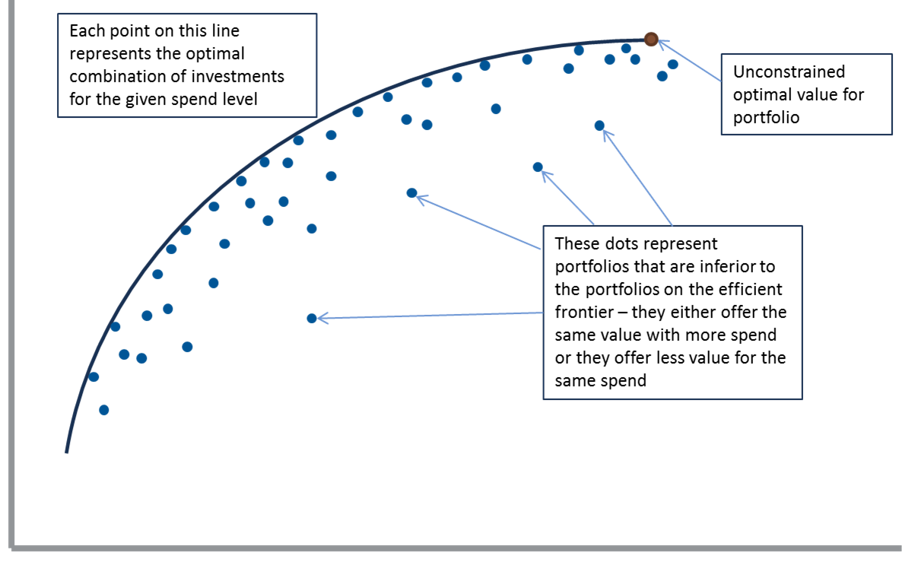
The theory assumes that investors are risk-averse. And employs the core idea of diversification. Portfolio Frontier/Efficient Frontier
MODERN PORTFOLIO THEORY
Expected Return
Standard Deviation/Risk
Notes:
risk-averse; for a given level of expected return, investors will always prefer the less risky portfolio. Diversification – owning a portfolio of assets from different classes is less risky than holding a portfolio of similar assets
A typical portfolio front

Slide 4
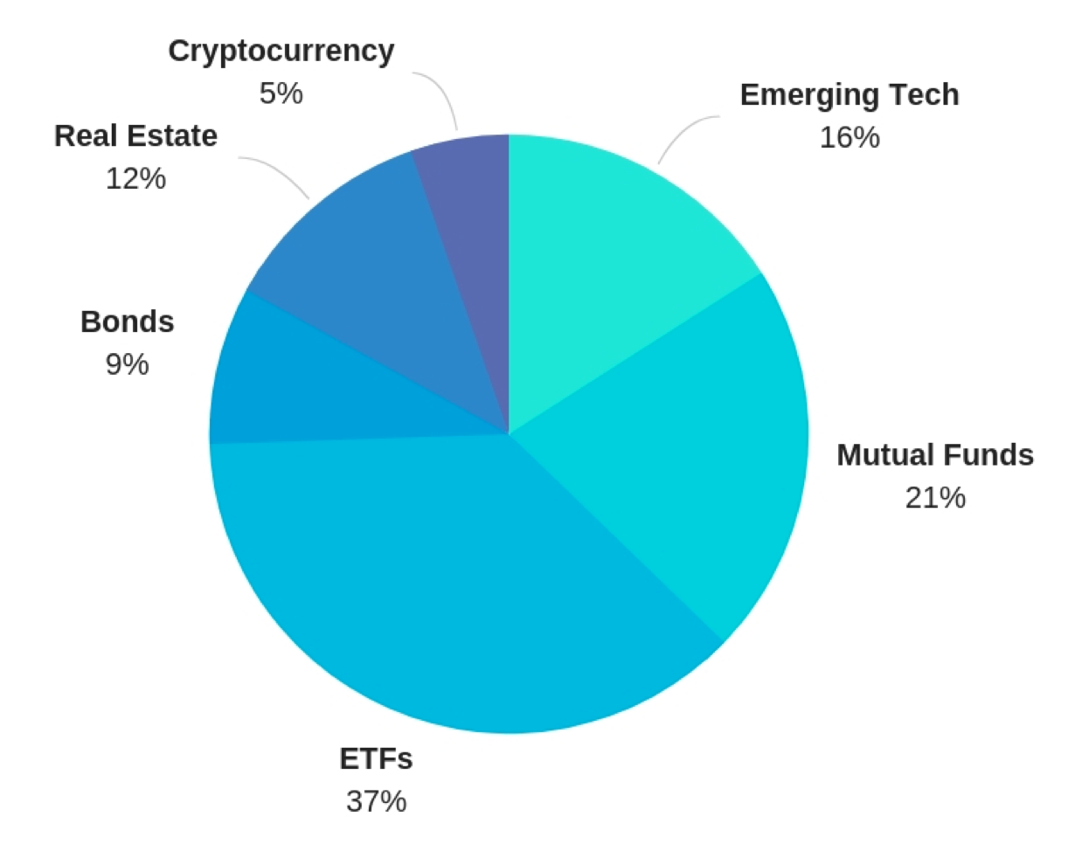
A good portfolio is more than a long list of good stocks and bonds. It is a balanced whole, providing the investor with protections and opportunities with respect to a wide range of contingencies. – Harry Markowitz
Portfolio Selection
Goals:
Maximize returns
Minimize risk
Stay within budget
Inputs:
Historical price data
Budget
Risk tolerance
Output:
A portfolio representing a list of investments and the expected return
Notes:
How do we define risk?

Slide 5
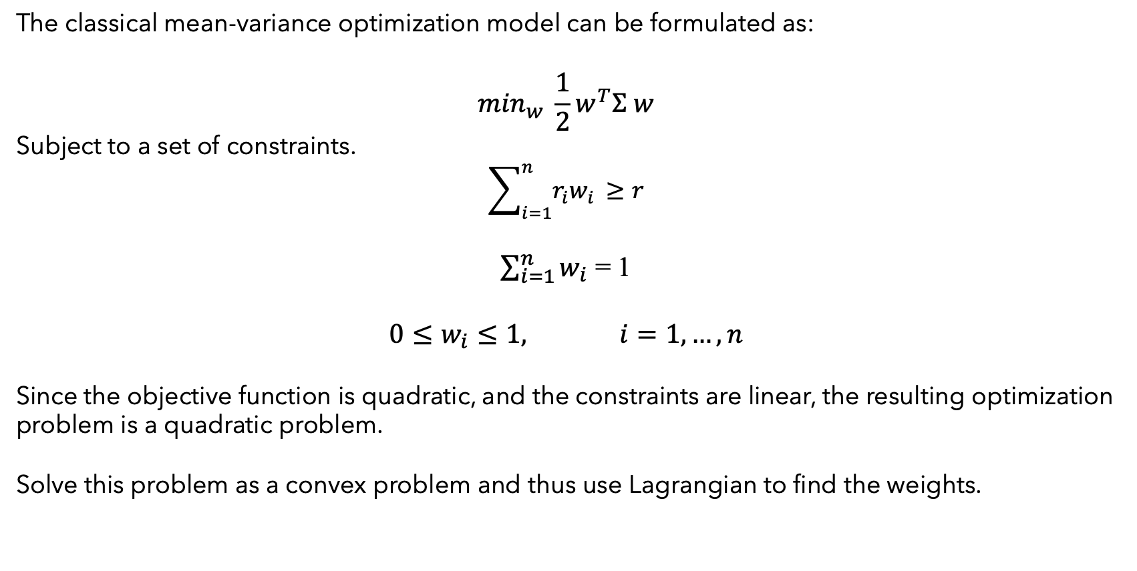
MATHEMATICAL MODEL
The classical mean-variance optimization model can be formulated as:
$$\min_{w} \frac{1}{2}w^{T}Σ w$$
Subject to a set of constraints.
$$\sum_{i=1}^{n}{r_{i}w_{i }≥r}$$
$\sum_{i=1}^{n}{w_{i}}$ = 1
$$0≤w_{i}≤1, i=1,…, n$$
Since the objective function is quadratic, and the constraints are linear, the resulting optimization problem is a quadratic problem.
Solve this problem as a convex problem and thus use Lagrangian to find the weights.
Notes:
Suppose that a portfolio contains n different assets. The rate of return of asset i is a random variable with expected value m_i. The problem is to find what fraction x_i to invest in each asset i in order to minimize risk, subject to a specified minimum expected rate of return.
The expected return should be no less than a minimal rate of portfolio return that the investor desires,
Covariance matrix is (n x n) matrix returns mu is (n x 1) vector. To optimize the portfolio we want to find the linear combination of assets weights which give the highest excess return, or we want to minimize the variance of our return. Weights are (n x 1) vector
Since constriants are linear and covariance matrix is positive definite.

Slide 6
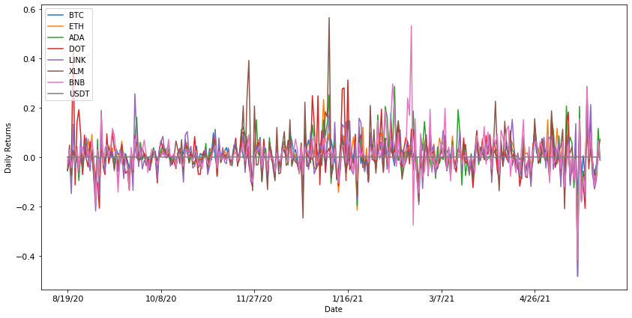
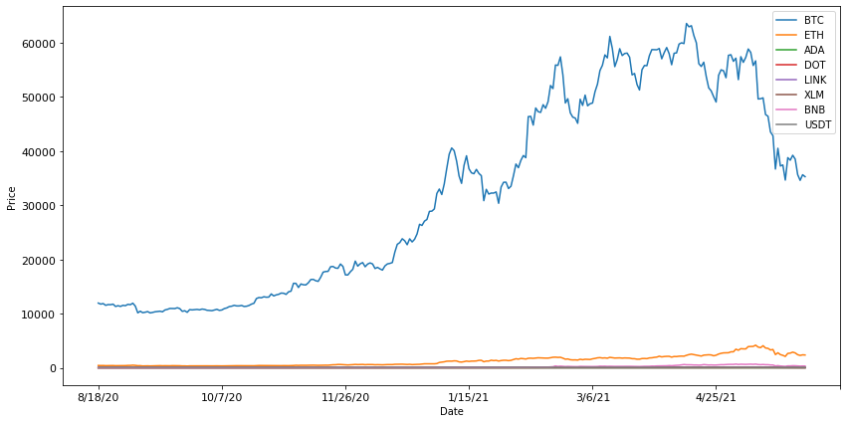
METHODOLOGY
By choosing cryptocurrencies from top 20 list.
Assets: Bitcoin (BTC), Ethereum (ETH), Cardona (ADA), Polkadot (DOT), Chainlink (LINK), Stellar (XLM), Binance Coin (BNB) and Tether (USDT).
Data: Historical closing price data. Computed the expected returns, standard deviation and correlation.
Notes:
Suppose that a portfolio contains n different assets. The rate of return of asset i is a random variable with expected value m_i. The problem is to find what fraction x_i to invest in each asset i in order to minimize risk, subject to a specified minimum expected rate of return.
The expected return should be no less than a minimal rate of portfolio return that the investor desires,

Slide 7
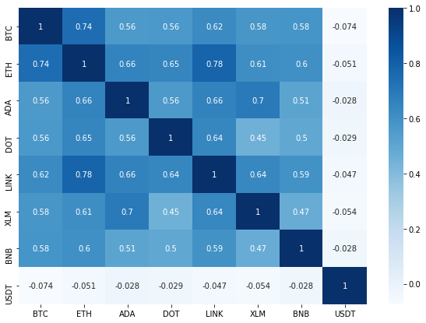
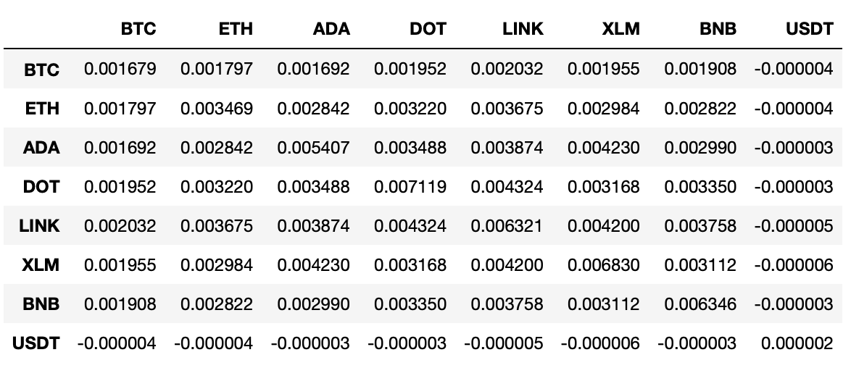
Rate of Return Correlation and Covariance Matrix

Slide 8
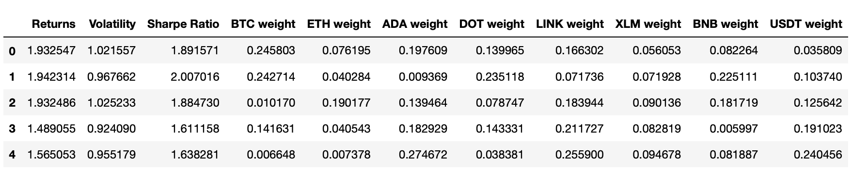
IMPLEMENTATION
By coding a simulation in python, historical data is used to simulate the modeling of 10,000 different portfolios by random generation of asset weights.
Optimal Portfolio: Portfolio with the maximum Sharpe Ratio.
Minimum Volatility Portfolio: Portfolio with minimum standard deviation.
Notes:
Suppose that a portfolio contains n different assets. The rate of return of asset i is a random variable with expected value m_i. The problem is to find what fraction x_i to invest in each asset i in order to minimize risk, subject to a specified minimum expected rate of return.
The expected return should be no less than a minimal rate of portfolio return that the investor desires,

Slide 9
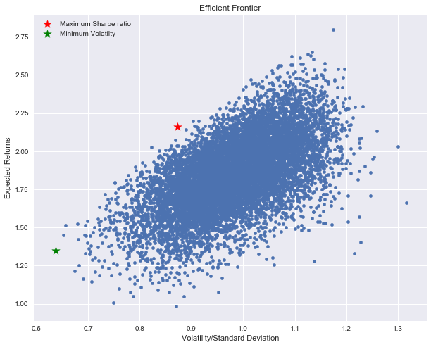
Efficient Frontier

Slide 10
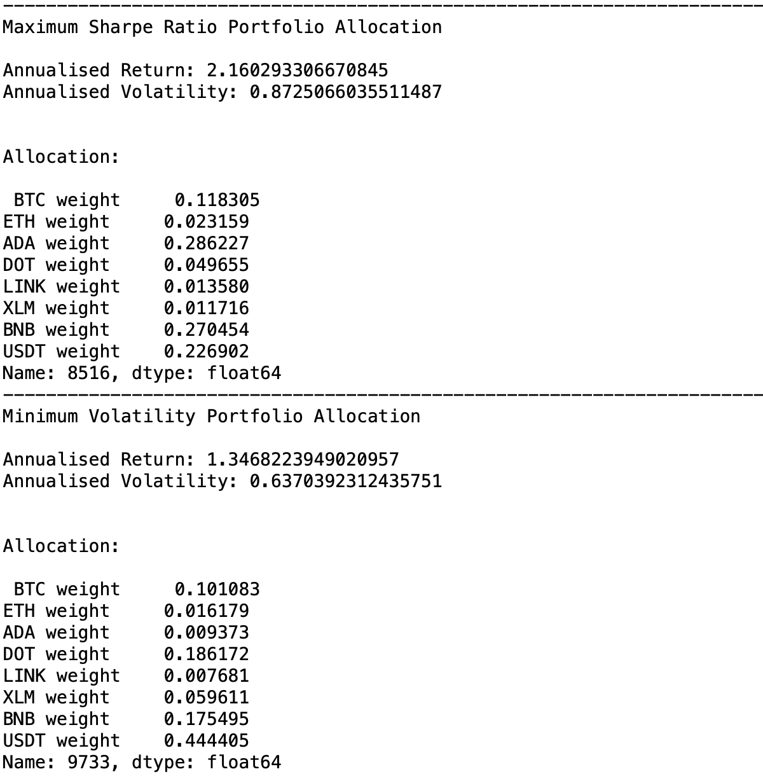
RESULTS

Slide 11
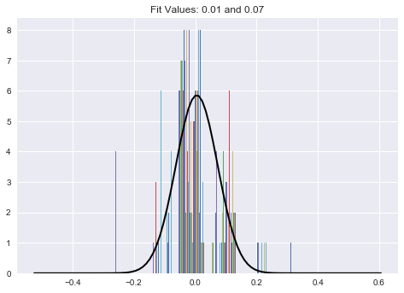
FUTURE WORK – VOLATILITY MODELS
Returns are assumed to be normally distributed.
However, some return distributions have fat tails. Standard deviation may not be a perfect measure of risk/volatility.
Therefore, we could explore other volatility models to represent risk.

Slide 12
FUTURE WORK - QUBO
Writing optimization problem as QUBO (Quadratic Unconstrained Binary Optimization) and solving with quantum annealing optimizer.

Slide 13
Thank You!

